Slide 1

EFFECTIVE MANAGEMENT STRATEGIES IN HEALTHCARE SECTOR
PUBLIC HEALTH SEMINAR
Ms Bono Nemukula
22 April 2026

Slide 2
Table of content
Scenario
Organization
Framework for effective health care management
Leadership
Governance
Financing
Service delivery
Quality of care
Workforce and resources
Team work
Monitoring and accountability
Risk and challenges
Actionable recommendations

Slide 3
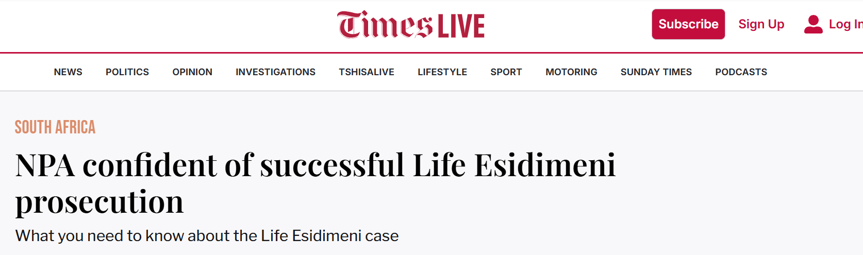
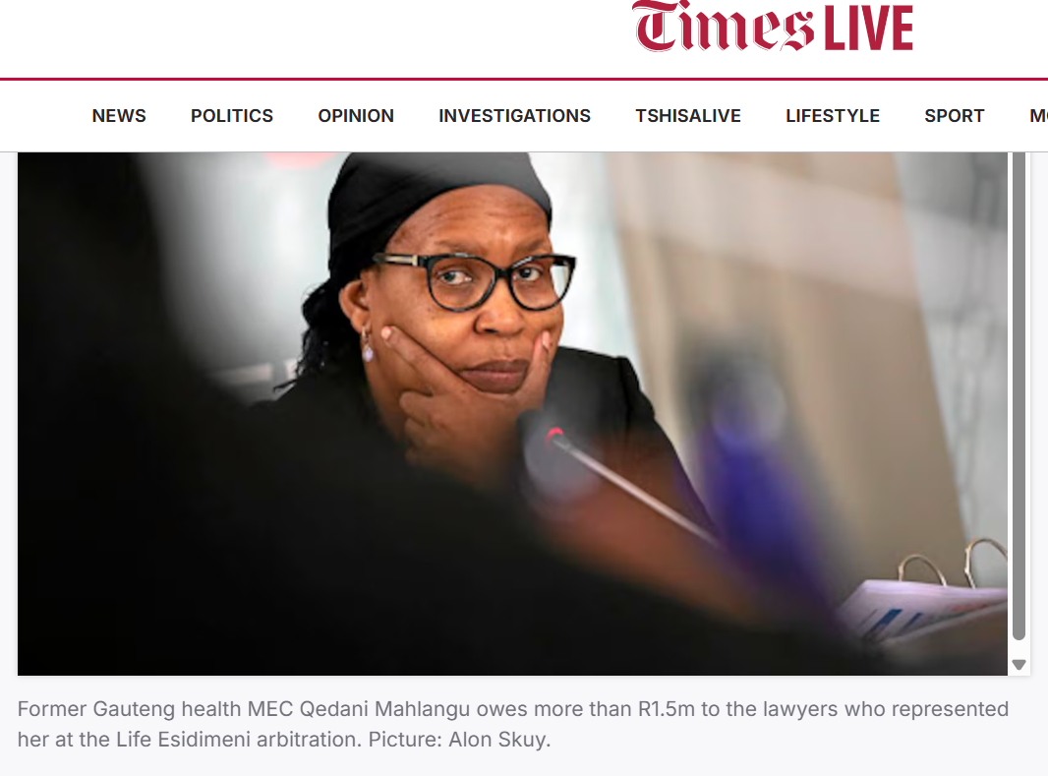
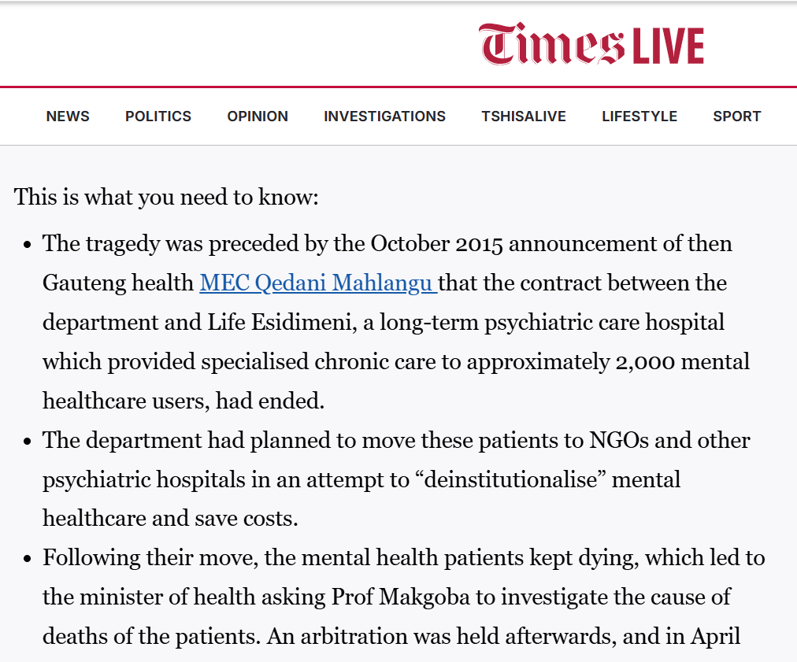
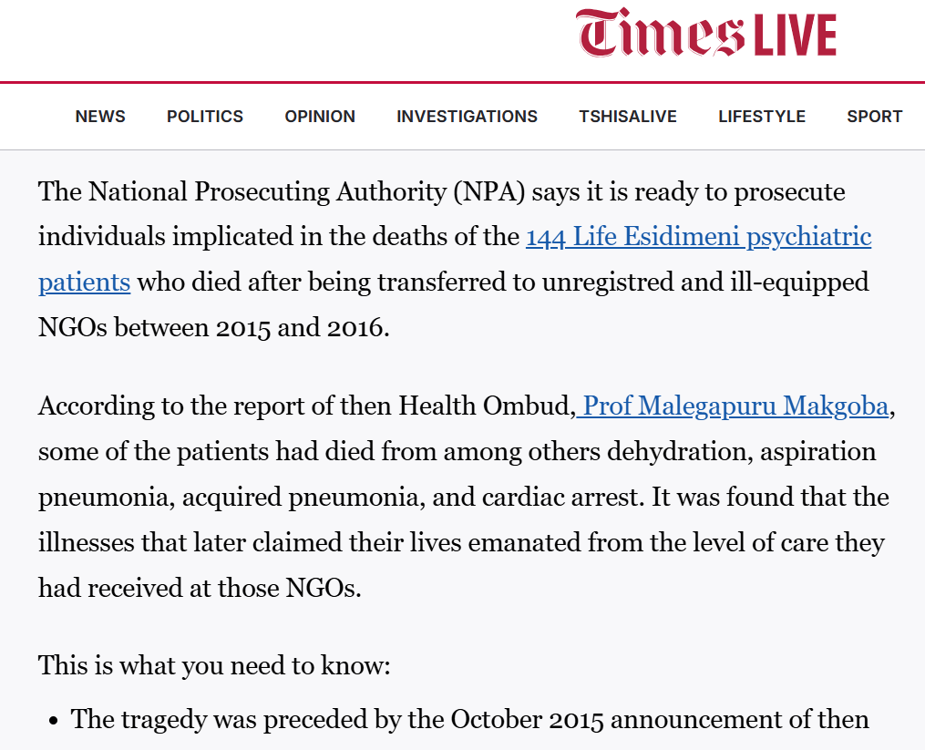
Scenario

Slide 4
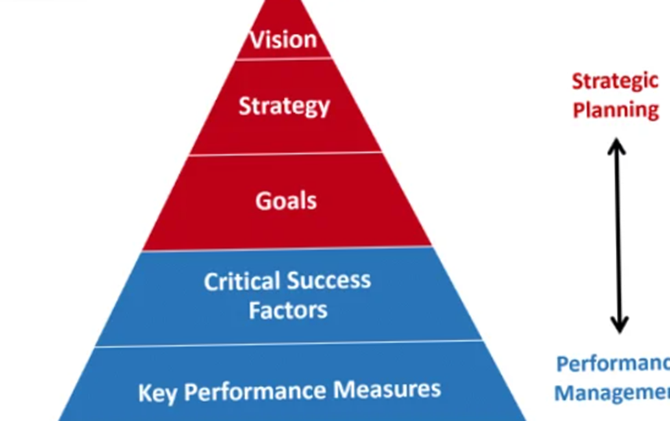
South Africa’s Health System at a Glance
“A long and healthy life for all for South Africans”
Increase life expectancy to 70 years
63,1 million population
9 provinces
52 Health districts
(8 Metro & 44 District municipalities)
3841 CHC’s & 3477 PHC’s
1500 private clinics
260 private hospitals
403 public hospitals

Slide 5
Quadruple burden of disease
Tackling:
HIV/AIDS,
TB,
high maternal/child mortality,
rising non-communicable diseases (NCDs), and
high injury rates
Mortality: TB is a top killer, while HIV, diabetes, and cardiovascular diseases (like stroke and hypertension) dominate. Stats SA reports a 58.7% rise in NCD deaths, with CANSA highlighting high TB/HIV co-infection rates

Slide 6
Drivers
Climate change
Air pollution
Poverty
Overcrowding
Rapid urbanization
Lifestyle change
Alcohol abuse and risky behaviors
Crime
Unsafe roads

Slide 7
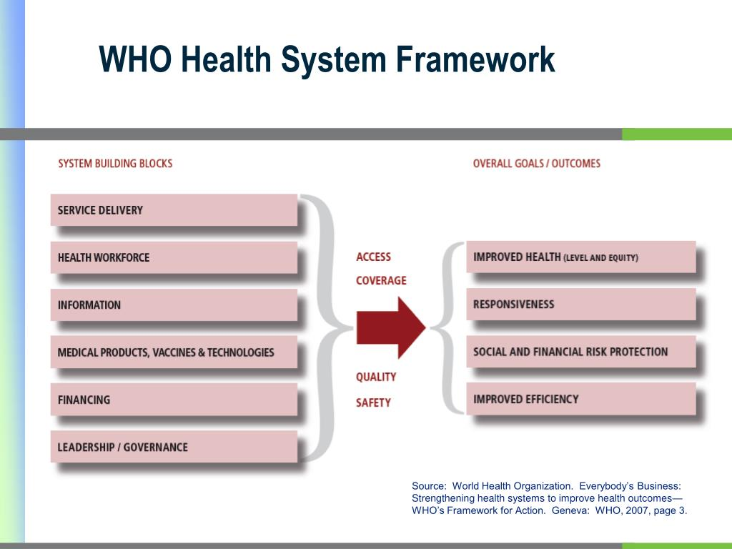
Framework for effective management
WHO Health System Framework – Six building blocks
PESTEL

Slide 8
Leadership
Political and administrative leadership
Leaders:
high Emotional Intelligence can understand their own emotions and those of their team members
Strategic thinking
Strong communication skills
Team building
Decision-making
Mentorship

Slide 9
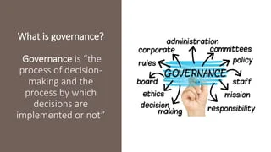
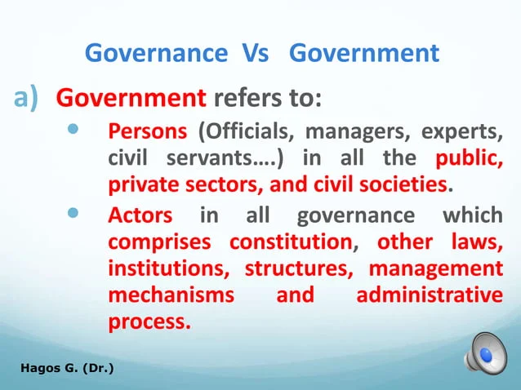
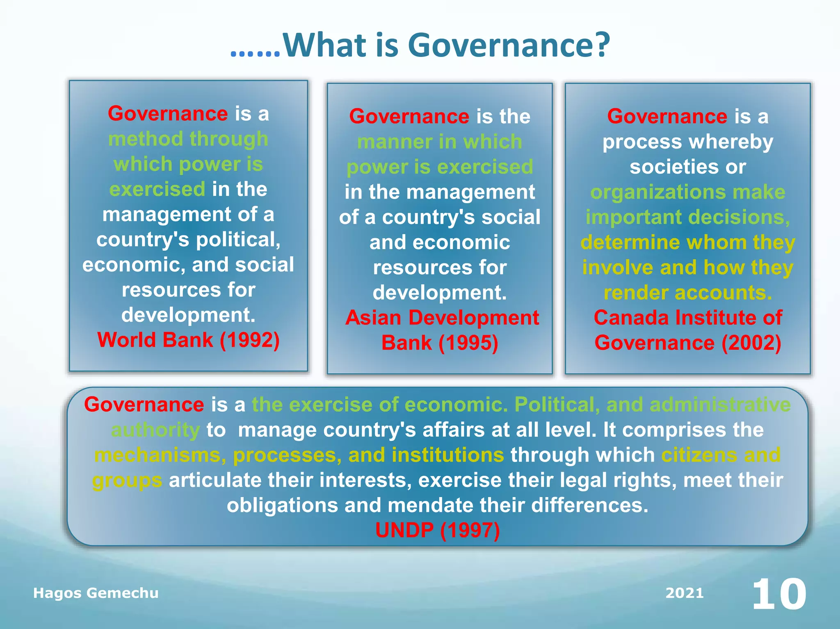
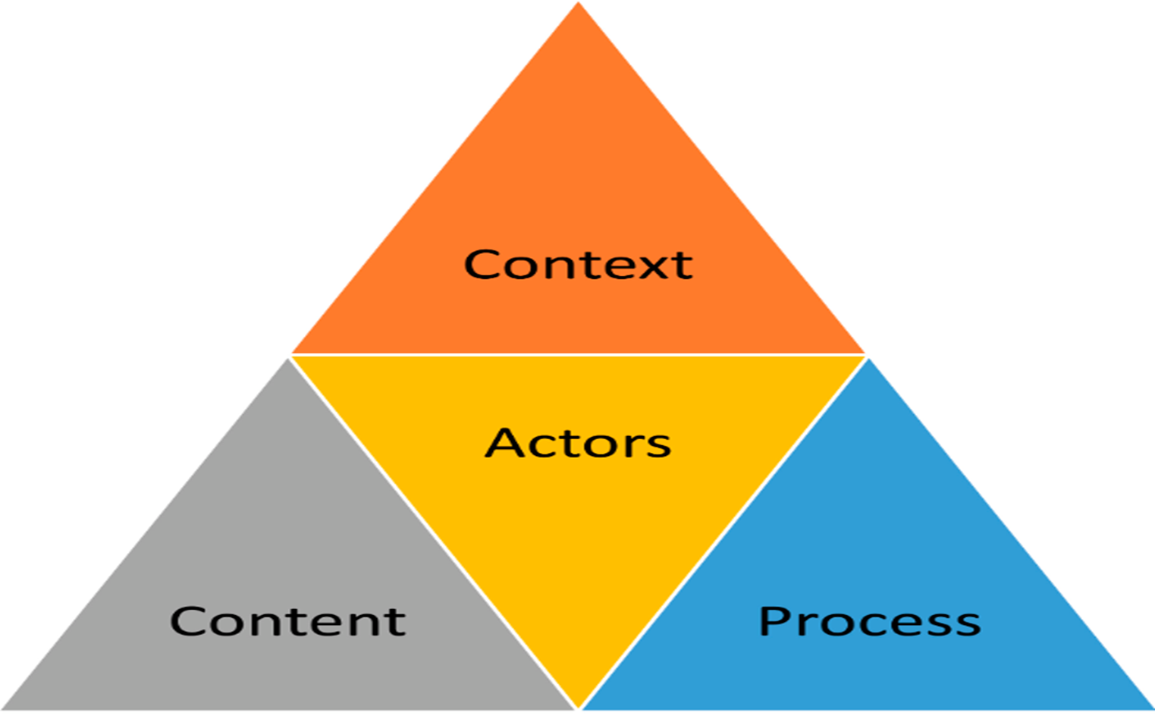
Governance
STRATEGIC POLICY FRAMEWORKS:
- Global commitments – COP & SDGs ,
IHR 2005, SADC Malaria Elimination 8
- National Development Plan 2030
- Presidential Health Compact
- National Health Act
OVERSIGHT AND ACCOUNTABILITY
COALITION-BUILDING WITH STAKEHOLDERS: Actor management strategies

Slide 10

Financing

Slide 11
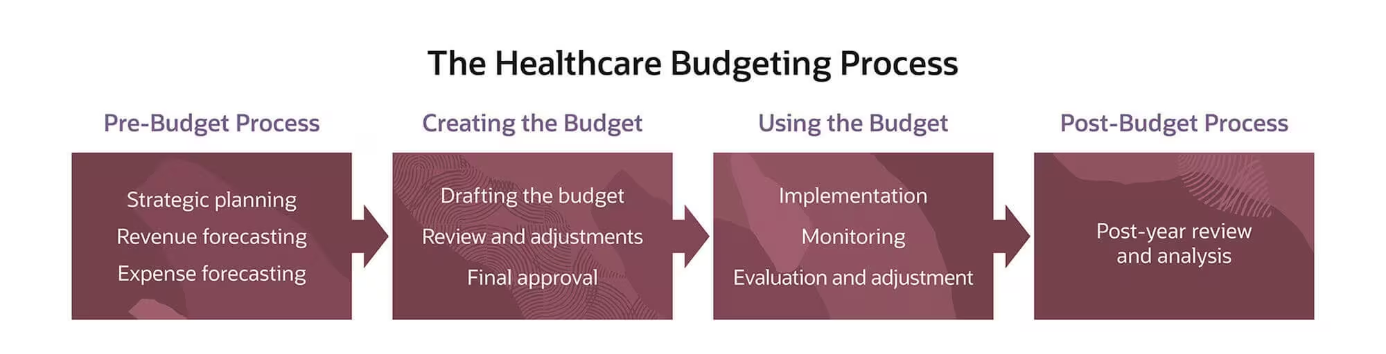
Financing
Public Finance Management Act
Municipal Finance Management Act
Auditor General
Public Protector

Slide 12
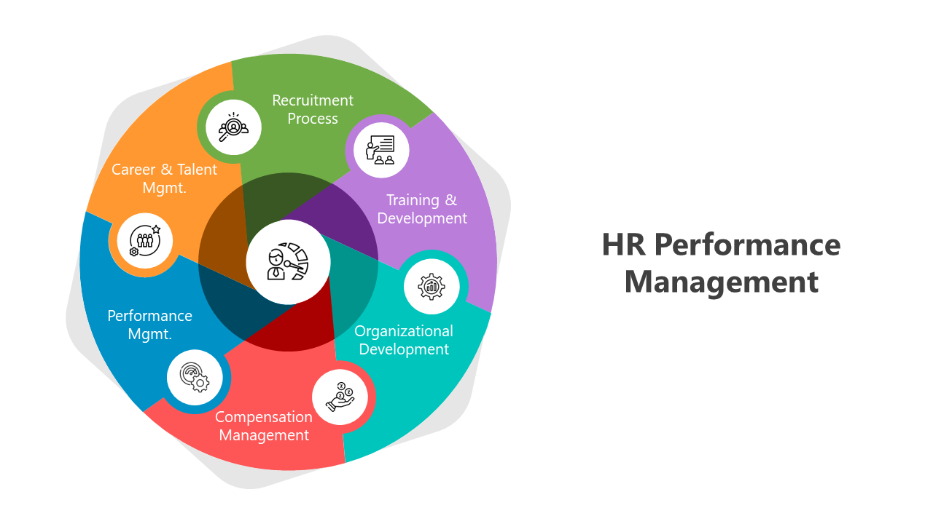
Workforce & Resources
Adequately trained health workers – scale up training institutions to meet demand
Continuous professional development – capacity building of health workers
Efficient resource allocation – tools of trade
Retention policies and staff wellbeing: rural allowances, housing, career progression. (Employee Wellness Programme)
Monitoring systems: integrate workforce data into national health information systems.
Global partnerships: leverage WHO and donor support for workforce strengthening.

Slide 13
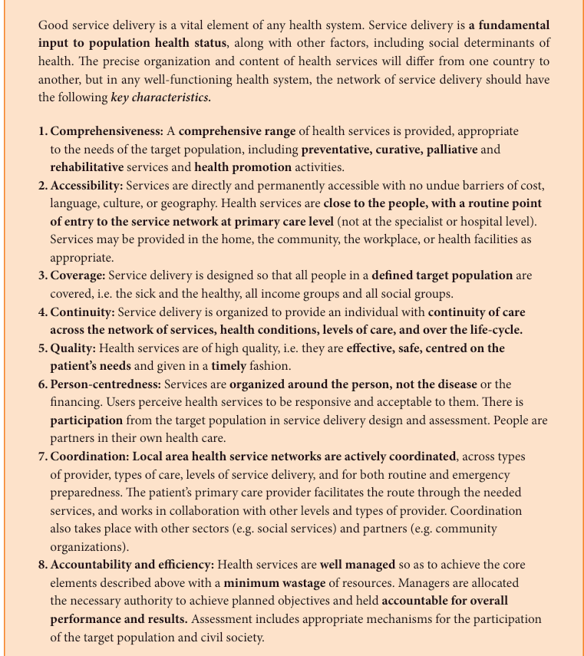
Service Delivery
Challenges in South Africa
Inequality: Urban area often have
better facilities than rural areas.
Workforce Shortages: Limited numbers
of trained healthcare professionals.
Infrastructure Gaps: Aging facilities and
insufficient equipment.
Financial Constraints: High costs of care
and limited budgets.
Financing in South Africa’s health system is central to understanding
why the country struggles with the quadruple burden of disease.
Financing determines the resources available, while service delivery
reflects how those resources are translated into care
Implementation of NHI: Ensuring smooth
rollout and sustainability of universal
coverage.

Slide 14
Programmes
Health Promotion: promoting healthy lifestyles and behaviors within communities. .
Disease Prevention: prevent the spread of diseases through vaccination campaigns, health screenings, and education about communicable diseases. They also monitor and respond to outbreaks to protect public health.
Disease management: the systematic prevention, diagnosis, treatment, and long‑term management of diseases, especially chronic and communicable conditions.
Hospital and other clinical care services: facility‑based health services provided by trained health professionals for diagnosis, treatment, rehabilitation, and emergency care such as ambulance services, pre‑hospital emergency care, stabilization, and patient transport.
Addressing Health Disparities: addressing social determinants of health, such as poverty, education, and access to healthcare.
Community Engagement: collaboration with local communities, government agencies, and organizations.
Research and Policy Development: to inform policy decisions and improve health outcomes. This includes studying health trends, evaluating program effectiveness, and advocating for health policies that benefit the community.

Slide 15

Digital Health
Digital healthcare applications are diverse and rapidly evolving:
Telehealth and telemedicine: Virtual consultations and remote monitoring, which have become standard in primary care and urgent care services.
AI and data-driven platforms: Tools for predictive analytics, personalized treatment recommendations, and population health management.
Wearable devices and mobile apps: Devices that track vital signs, physical activity, and medication adherence, supporting preventive care and wellness.

Slide 16
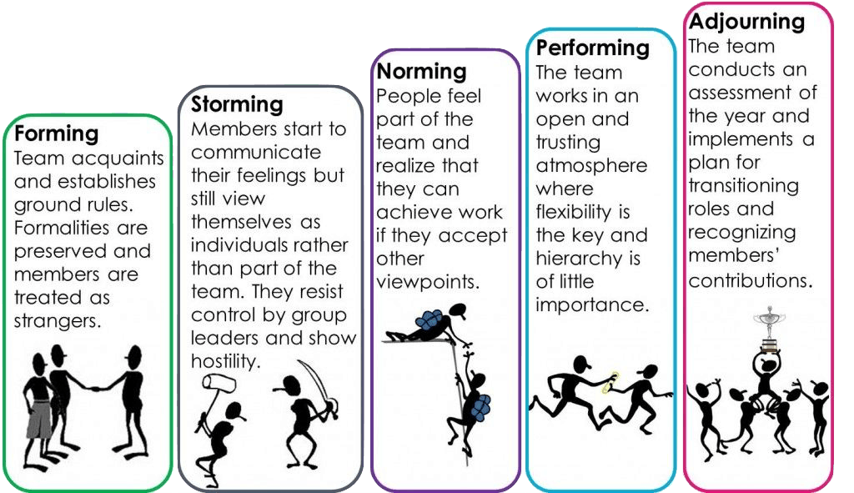
Team Work
Tuckman’s FSNP model (Models of team effectiveness)
Understanding the actors and leverage support – position and power strategy
Generational gaps

Slide 17


Monitoring & Accountability
Health information systems
Outcome monitoring
Transparent reporting

Slide 18
Risks & Challenges
Weak governance structures
Disease burden
Fragmented programmes
Resource constraints
Infrastructure and Equipment Challenges
Resistance to change
Information and Data management gaps

Slide 19
Actionable Recommendations
Strengthen primary healthcare systems
Invest in workforce training
Embed quality and safety standards
Enhance community participation
Use digital health tools for monitoring

Slide 20
Benefit of effective health care management
Improved Service Delivery | Accessible, equitable, continuous care
Better Health Outcomes | Lower mortality, reduced disease burden
Efficient Resource Use | Sustainability, minimized waste
Workforce Performance | Higher quality, reduced shortages
Financial Protection | Affordable care, universal coverage
Patient-Centered Care | Trust, satisfaction, adherence
Resilience to Shocks | Continuity during crises
Innovation & Integration | Modernized, coordinated systems

Slide 21

All hands on deck together we can do more
ETHICAL CONSIDERATION
Ethical leadership
Respect for others
Accountability
Ensuring fairness

Slide 22
THANK YOU

